Slide 1
Monthly Sales Report
Vishal Raj

Slide 2
Project Objective
To understand the monthly revenue of the business.
To understand the top-category product contributing to the revenue.
To understand the top sub-category product contributing to the revenue.
To understand market trends, and product demands to optimize business process.

Slide 3
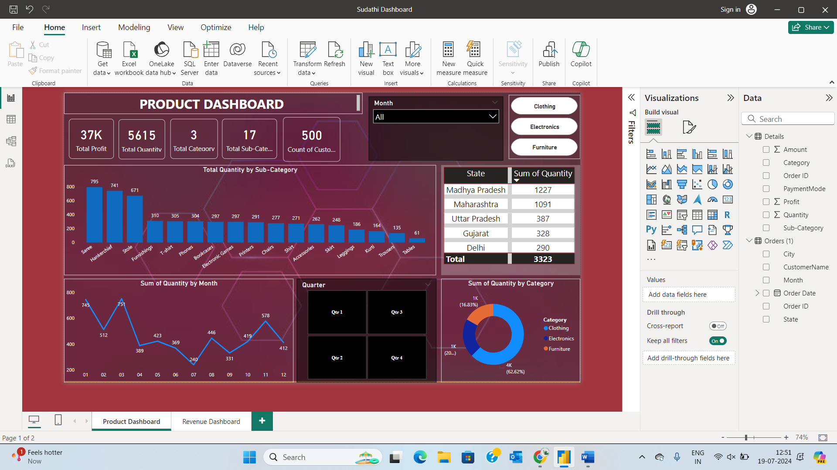
Current Month – December 31st
The order in the month of December dropped by xx% from the previous month.
Total profit earned 37k under three product categories selling 5600 quantities and generating a revenue of 438k.

Slide 4
Product Dashboard
The highest order received was in the month of March.
The lowest order received was in the month of July.
The highest top 3 products in the subcategory – Saree, Hankerchief, and Stole.
Clothing in the product category has the highest orders.
The lowest 3 products in the sub-category – Kurti, Trousers, and Tables.

Slide 5
Product Dashboard
The highest top 5 states – Madhya Pradesh, Maharashtra, Uttar Pradesh, Gujarat, and Delhi.
Madhya Pradesh has the highest quantity with 1,227 units.
The highest order was received in the category of Clothing.
The lowest order was received in the category of Furniture.

Slide 6
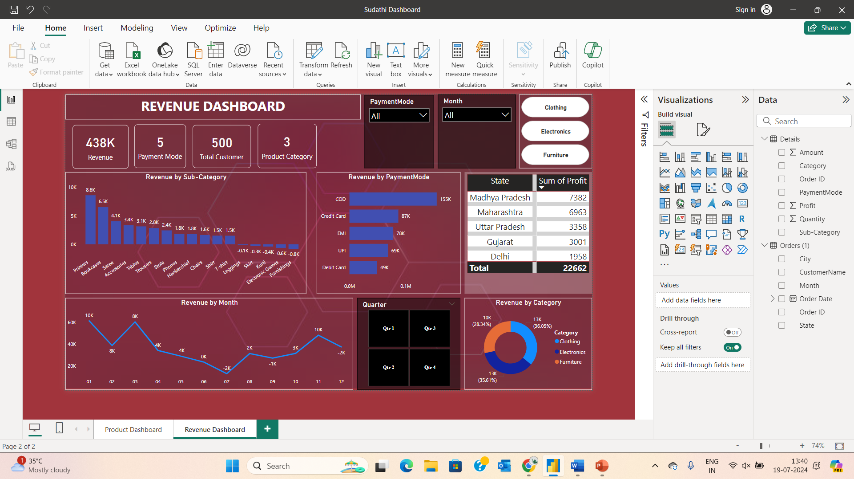
Revenue Dashboard
The highest revenue generated top 3 products in the subcategory – Printers, Bookcases, and Saree.
The lowest 3 products in the sub-category - Kurti, Electronic Games, and Furnishing. These sub-categories are at the bottom, with negative or very low revenues.
The highest revenue generated by the Cash on Delivery payment mode.
The lowest revenue generated by the Debit Card payment mode.

Slide 7
Revenue Dashboard
The highest revenue was generated in the category of Clothing.
The lowest revenue was generated in the category of Furniture.
The highest revenue was in the month of January.
By July, the revenue was at its lowest (-2K).

Slide 8
Revenue Dashboard
The highest top 5 profit generated states – Madhya Pradesh, Maharashtra, Uttar Pradesh, Gujarat, and Delhi.
Madhya Pradesh has generated the highest profit of 7382.

Slide 9
Thank You

